Slide 1
Welcome Monsoon Coders ! Editable Templates & Logs
12.Nov.2021

Slide 2
Agenda
Editable Templates
Advantages of using editable templates
How to work with editable templates
Logs
Default AEM logs
Creating custom logs

Slide 3
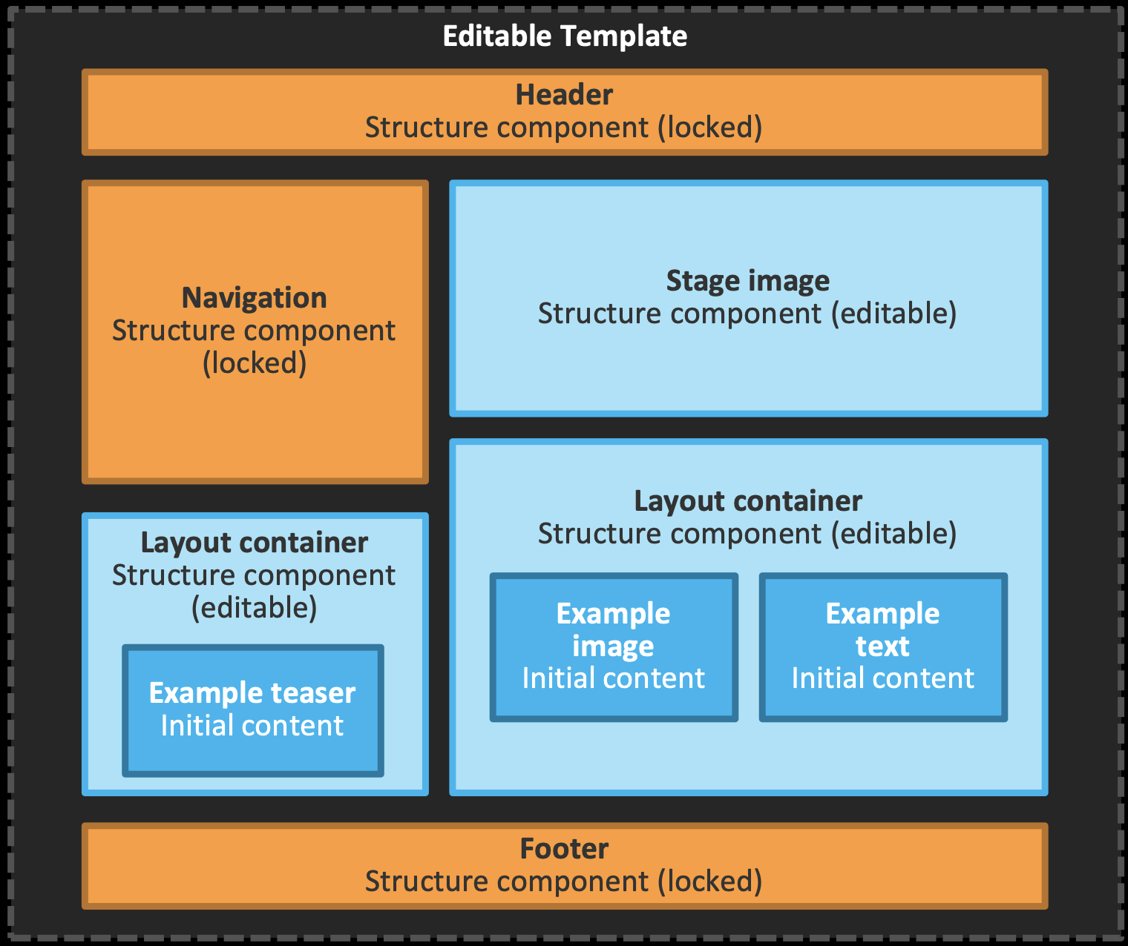
Editable Templates
What are Editable Templates
Replaces static templates
Structure, allowed components and policies
are stored as configuration, not hard-coded
Stored in /conf instead of /apps
Separates roles
Developer, Page Author, Template Author

Slide 4
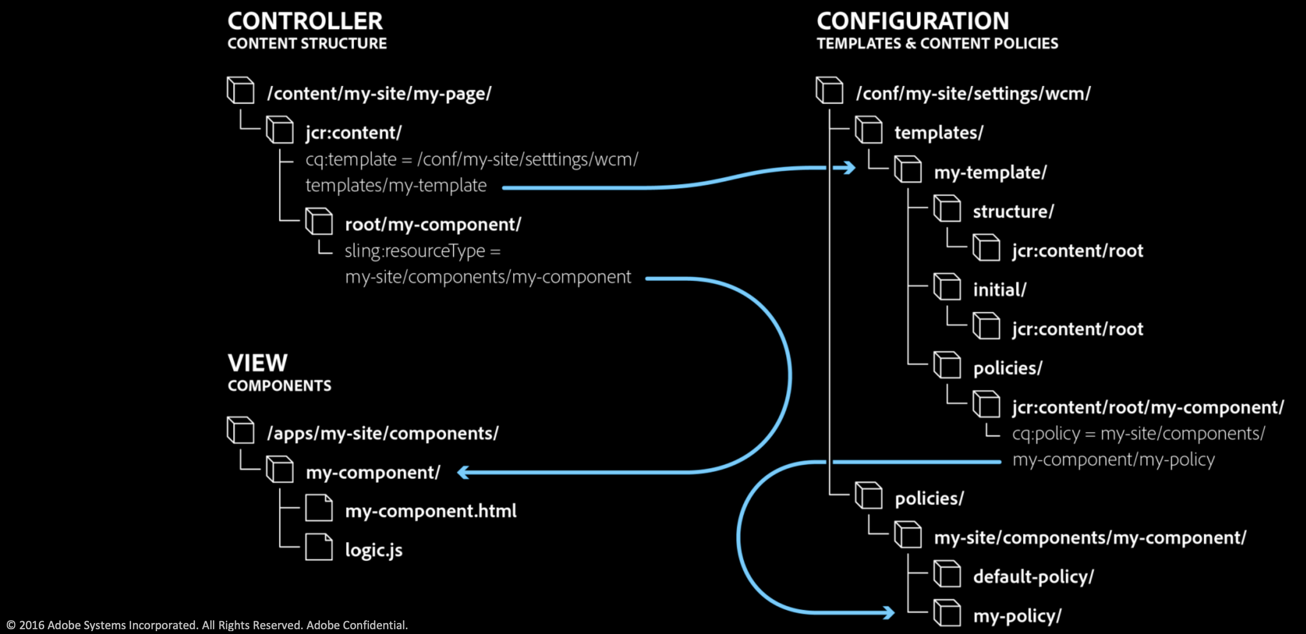
Editable Templates
Editable Template Content Structure

Slide 5
Editable Templates
Challenges & Solutions
Keep in mind: Every editable template is based on a page component – like static templates
Policies for components in nested parsys not supported
Semantic naming - Adding components in structure view leads to node names like responsivegrid_676359182 Policies are named like policy_13967744492500
Rename auto-created nodes manually before using the template in production

Slide 6
Editable Templates
Demo
http://localhost:4502/

Slide 7
Logs
Types of Logs in AEM
crx-quickstart/logs
Request.log
Access.log
Stdout.log
Stderr.log
Audit.log
History.log
Error.log
Upgrade.log

Slide 8
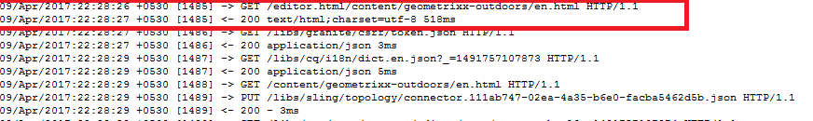
Logs
Request.log
This log file contains each request together with response related to AEM instance.
By this log file we can easily monitor the performance of AEM instance.
Each request contains the following information:
Method (GET, POST,HEAD,PUT,DELETE)
Resource Path (/content/geometrixx-outdoors/en.html)
Protocol (HTTP/1.1 or HTTPS)
Each response contains the following information:
Status Code (404,200,401 etc)
MIME Type: (text/html, image/jpeg etc)
Response Time (518 ms)
By analyzing, we can easily determine that which request and response is taking too much time.
By this we can increase overall site performance.
Request.log
Access.log
Stdout.log
Stderr.log
Audit.log
History.log
Error.log
Upgrade.log
Fig- Request.log

Slide 9
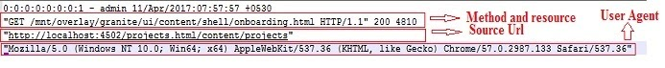
Logs
Access.log
This log file is almost similar to request.log. It helps us to know the following things:
Who is accessing
Which resource is being accessed
At what time resource is being accessed
The requests in access.log is exactly half of request.log because the access.log defines
all the request and response in just one line. Each line in Access.log contains the following information:
Access IP - The IP of that system from where the request is coming.
Access User - The user who is sending the request.
Access Time - At what time resource is being accessed.
Request Method- The method of the request like GET, POST, PUT etc.
Access Resource - The resource which is accessed by user.
Protocol like HTTP/1.1 or HTTPS
Content Length - It determines the length of response content.
Referrer URL - The referrer is the web page that sends visitors to your site using a link. In other words,
it’s the web page that a person was on right before they landed on your page.
User Agent- It refers to a web browser telling a website information about the browser and operating system.
Fig - Access Log

Slide 10
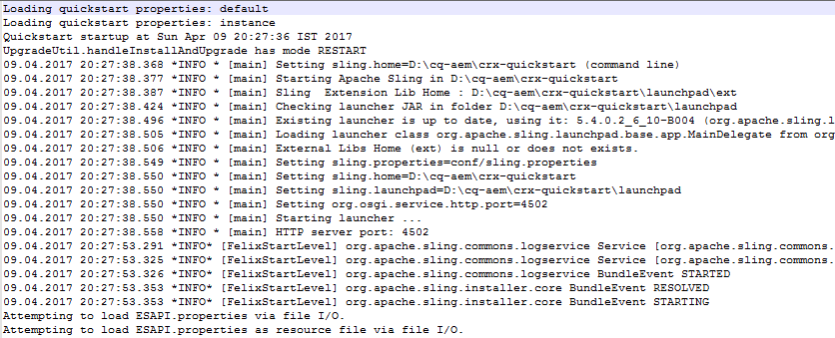
Logs
Stdout.log
This log file basically contains the startup log. Here startup log means whenever any AEM instance created or started then it will hold the information about AEM instance like the sling.home, Apache sling etc.
Stdout.log is also useful to see the message given in java classes.This can be done by using System.out.println(); Even we can also able to see the log messages related to com.day.cq.mail.service.

Slide 11
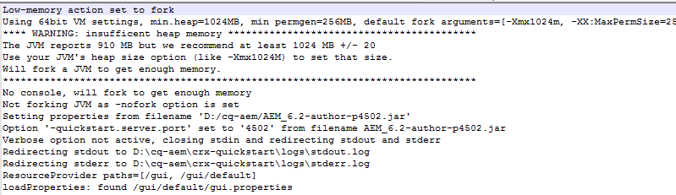
Logs
Stderr.log
This log file contains error messages of varying levels of severity. Some AEM instance related messages generated during startup like:
The JVM reports a heap size of 3618 MB, meets our expectation of 1024 MB +/- 20 .
Note: By default the log level is set to Warning (WARN).

Slide 12
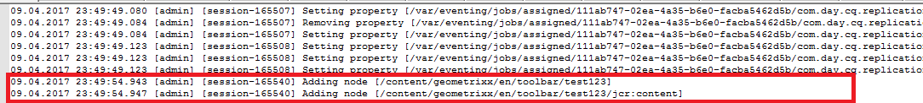
Logs
Audit.log
This log file is used by Jackrabbit to log changes to the repository.
By default this log file is set to level info. There is not much logging going on at this level because of which
audit.log seems to be empty. If you set this log file to log level debug you will see log messages every time
you make changes to the repository. For example if you add a component to a page, delete a page etc.

Slide 13
Logs
History.log
History.log: This log file contains the information about which action is performed on the content.
It contain high level logs about the actions performed by editors (actions can be edit, view, delete etc).This log is probably only relevant on author instances.
Each line contain the following information:
TimeStamp
Action
User
Content path
Content type(cq:page, dam:asset)

Slide 14
Logs
Upgrade.log
Provides a log of all upgrade operations that runs
from com.day.compat.code upgrade and com.adobe.cq.upgradesexecutor package.
By default, this log level is set to info.

Slide 15
Logs
Error.log
Error messages (of varying levels of severity like INFO, ERROR, DEBUG, etc.) are registered here.
Hierarchy of log4j logging levels are as follows in Highest to Lowest order
TRACE
DEBUG
INFO
WARN
ERROR
Note: The high level logs contains all the logs of lower levels like in case of Trace log level,
it will include all the logs of debug, info, warn and error as well

Slide 16
Logs
Create Your own Custom Loggers
Creating Your Own Loggers and Writers
You can define your own Logger / Writer pair:
Create a new instance of the Factory Configuration Apache Sling Logging Logger Configuration.
Specify the Log File.
Specify the Logger.
Configure the other parameters as required.
Create a new instance of the Factory Configuration Apache Sling Logging Writer Configuration.
Specify the Log File - this must match that specified for the Logger.
Configure the other parameters as required.

Slide 17
Editable Templates
Demo
http://localhost:4502/

Slide 18
Practice, Practice, Practice
Next Steps
Please create your own Editable Templates and Custom Logger in AEM and practice

Slide 19
Thank You!

